Slide 1


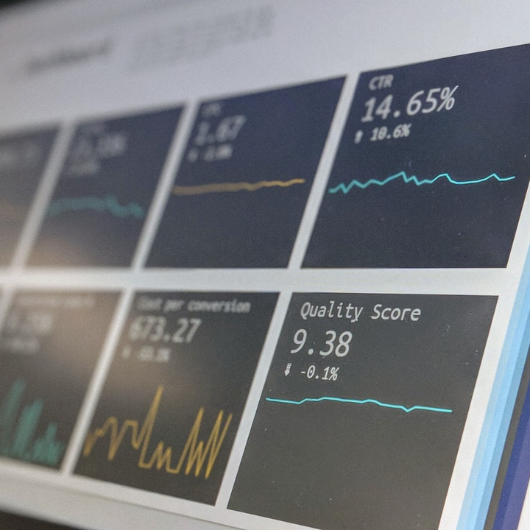
Group 1 Retail Data Project

Slide 2



The data
Beacons dataset provided by Blesh
Data collected in shopping outlet in Istanbul
Have details of when consumers with compatible apps were in proximity of the beacons, with date, time and proximity information recorded

Slide 3


The challenge
Main aim is to predict future sales/visits using the existing data.
3 different modelling approaches shared by Cheuk for air quality dataset
SVM, ARIMA & LSTM approaches to be explored as a group

Slide 4
The Data
There are 14 columns in the dataset we were provided.
Merchant ID and Dongle ID have identical values for every record, so aren’t of much use to us for this problem.
ID and GTID are practically unique to each row, so also do not prove too useful.
Subscriber ID denotes an individual customer, so we can use this paired with the entry and exit dates to learn when and for how long they were within range of the beacons.
Data has more entry than exit records so assume an exit record = a sale
ID : table row id
GTID : global transaction id
VENDOR_ID : application id
SUBSCRIBER_ID : user id
MERCHANT_ID : merchant id (2133) of our merchant
SIGNAL_TYPE : type 2 (Enter) or type 4 (Exit) signal
ENTRY_DATE : login timestamp (e.g. '2017-09-20 00:12:58.000000')
EXIT_DATE : logout timestamp, like ENTRY_DATE, only for Exit Signal
LATITUDE : latitude of the location of where the signal's from
LONGITUDE : longitude of the location of where the signal's from
DONGLE_ID : device_id (5536)
DISTANCE : distance to where the signal's from (in meters), only for Enter Signal
PROXIMITY : proximity value ('unknown', 'far', 'immediate', 'near'), only for Enter Signal
RSSI : signal power (less negative = stronger signal), only for Enter Signal

Slide 5

What we did– data preparation
Count the number of unique visits (subscriber_ids) per each day in the data, average time spent per visit and distance information calculated, missing/extreme data handled at this point
Found other sources of data to augment, local weather (worldweatheronline API) and stock market info for BIST 100. This might impact on retail behaviour during the period
Standardise data for SVM, max-min scale data between 0 and 1 for LSTM

Slide 6

The plan – data Modelling
We plan to divide the different modelling approaches within the group, with some targeting SVM and others targeting ARIMA/time series models ahead of Feb 2nd
Aim is to start with example code from Cheuk as baseline approach and either optimise hyperparameters, or explore alternative approaches within this framework (referencing the time series book for ARIMA group)
Once these approaches have been exhausted, we will regroup and explore the LSTM approach, this may follow after the Feb 2nd presentation time depending

Slide 7

The plan – Results
Comparison of performance of best models from each framework will be conducted
A review of each process will complement this identifying key learnings and potential areas for improvement

Slide 8
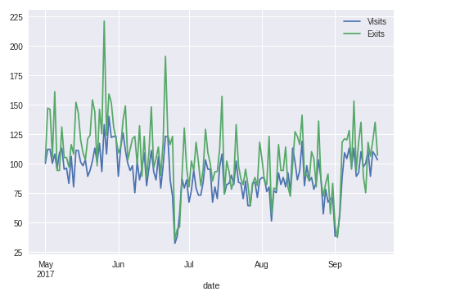


ARIMA

Slide 9
ARIMA model
We have count of number of unique visitor and the number of exit signal each day. Assuming an exit indicates a sale, we will model the no of visitor and use this to estimate the number of sale/transaction.
First of all, we plot the number of visits and exits on the same graph. Both series follow a similar pattern. Hence the model fitted for visits can also be useful for modelling
exits.

Slide 10
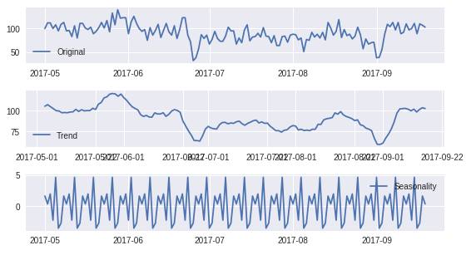
ARIMA model
ARIMA models take into account seasonal and trend in the data, denoted by the parameters (p,d,q). The parameters have the following meaning: p=no of autoregressive part, d=order of differencing, q=no of moving average part.
To determine appropriate parameters for the model, we use decomposition to identify whether trend or/and seasonality exit in the data.
ts1=ts['Visits']
decompositts1ion=seasonal_decompose(ts['Visits'])
trend=decomposition.trend
seasonal=decomposition.seasonal
residual=decomposition.resid
There is no particular trend but there is indeed seasonality.

Slide 11
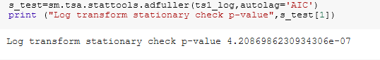
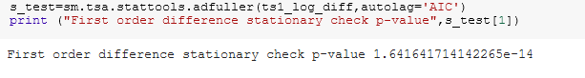
ARIMA model
We need to stationarize the series which can be done by log transform and differencing. Then we can use the Dickey-Fuller test to determine if the series is stationary. Taking the log will stabilize seasonality while differencing will stationarize trend. The p-values of the tests of the transformed series are small. Hence we say the series is stationary.

Slide 12
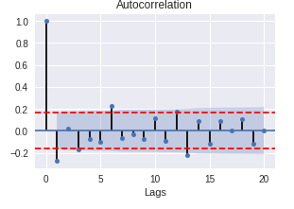
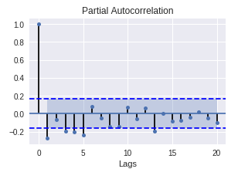
Arima model
Next we do the autocorrelation test to find out suitable values for p and q. We have taken first difference of the series so d=1.
Both ACF and PACF show big positive spike at lag=1. Hence we use p=1. There is no obvious moving average component so we take q=0.

Slide 13
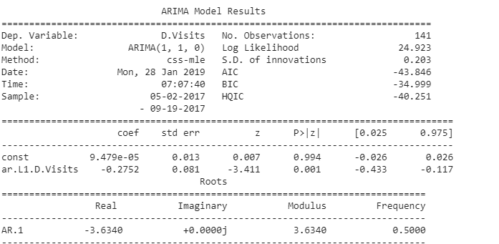
Arima model
Having identified the appropriate parameters, we fit the ARIMA model(1,1,0).
#build model
model1=sm.tsa.ARIMA(ts1_log,order=(1,1,0))
results1=model1.fit(disp=-1)
#evaluate model
print(results1.summary())
To identify whether we have a good model, we compare the values of AIC,BIC between different models. The smaller these values, the better.

Slide 14
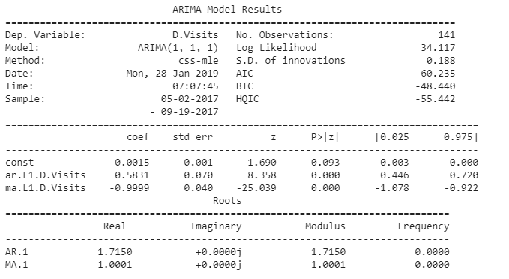
Arima model
We also tried adding the MA component to the parameters and fit a ARIMA(1,1,1) to the data. There is slight improvement as AIC and BIC figures are smaller.

Slide 15
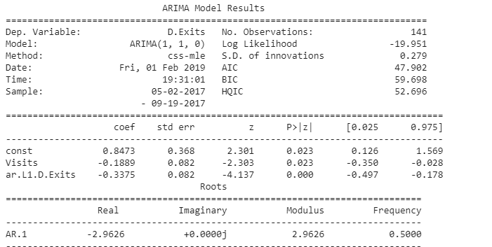
Arima model
Let’s apply the same models to predict the exit data using the exit data.
model3=sm.tsa.ARIMA(endog=ts2_log, exog=ts_lag, order=(1,1,0))
results3=model3.fit(disp=-1)
#evaluate model
print(results3.summary())

Slide 16
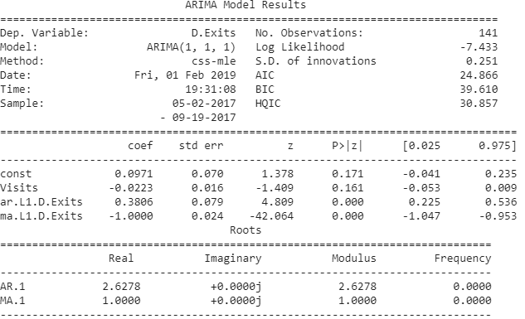
ARIMA model
Let’s also try the ARIMA(1,1,1) model. Again the ARIMA (1,1,1) appears to be a better fit to the number of sales with smaller values for the model selection statistics AIC,BIC and HQIC.

Slide 17
Arima model
Conclusion:
ARIMA (1,1,1) seems to work for both series. Further work required to try out different parameters to identify the best model.

Slide 18
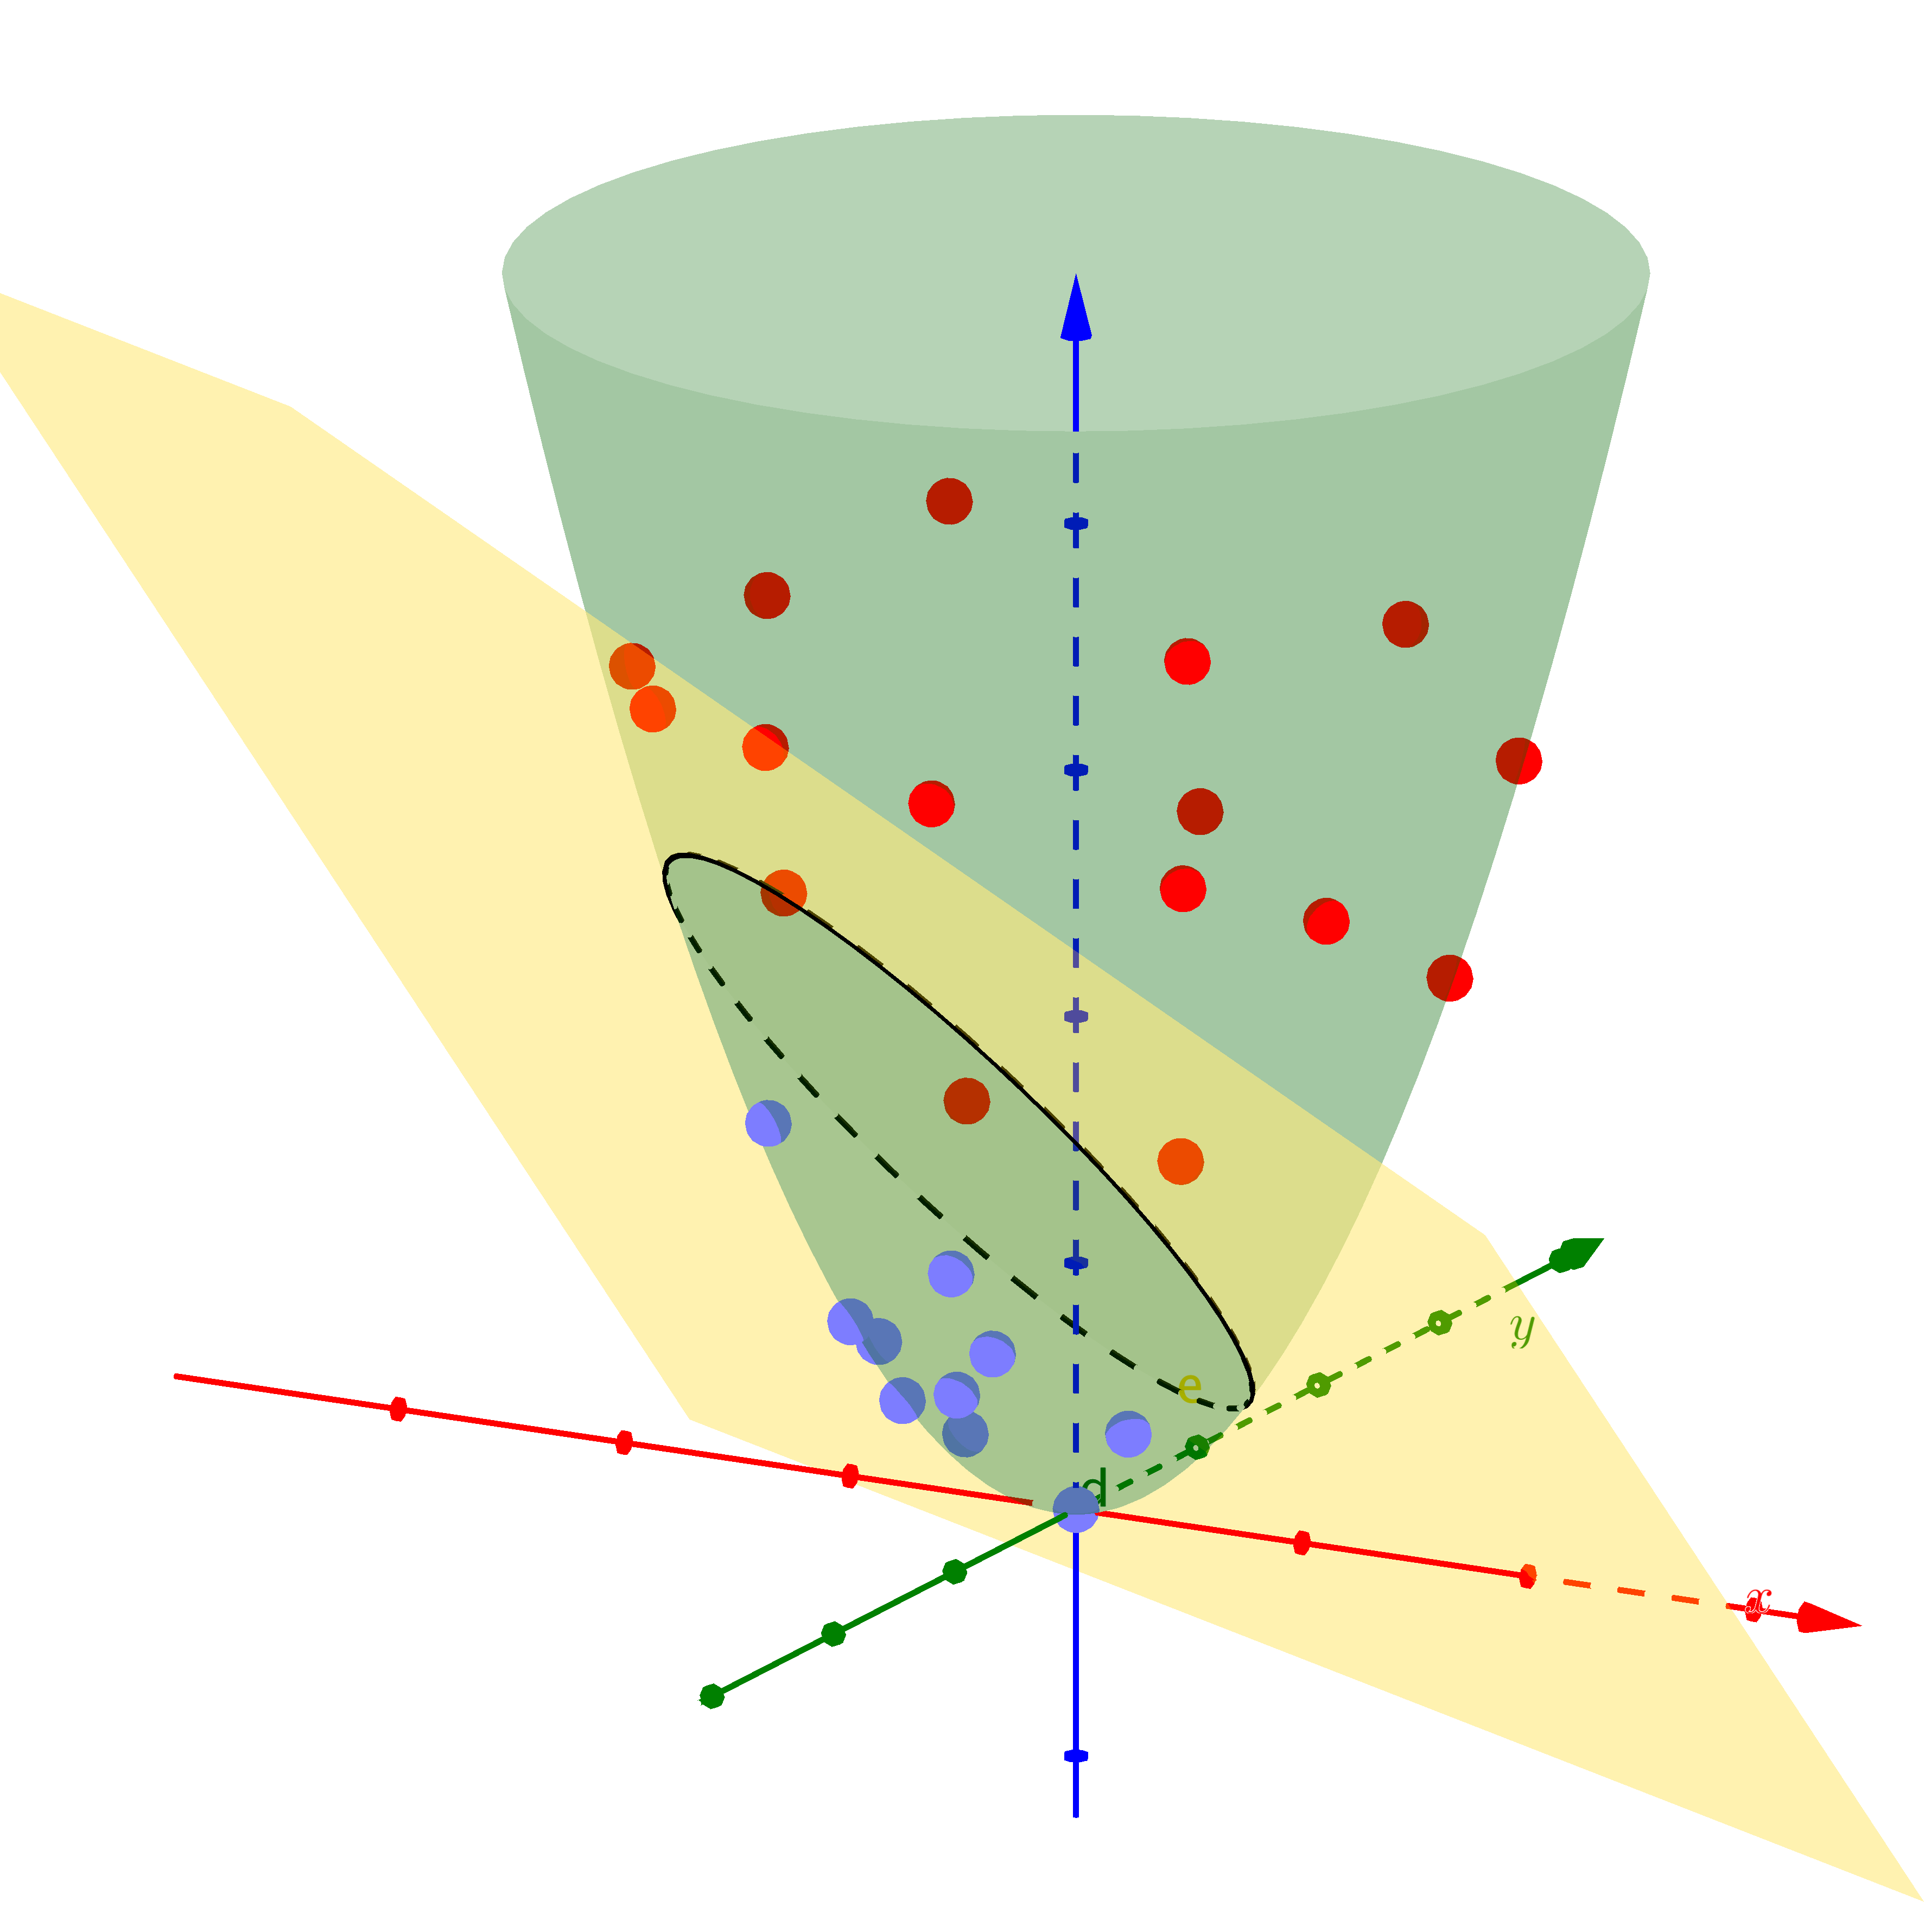


Support vector machine

Slide 19
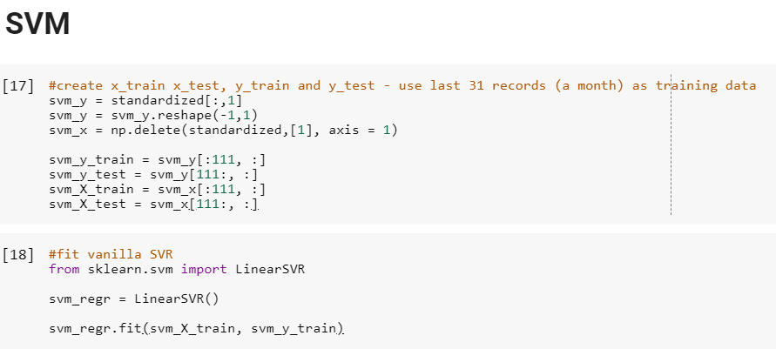
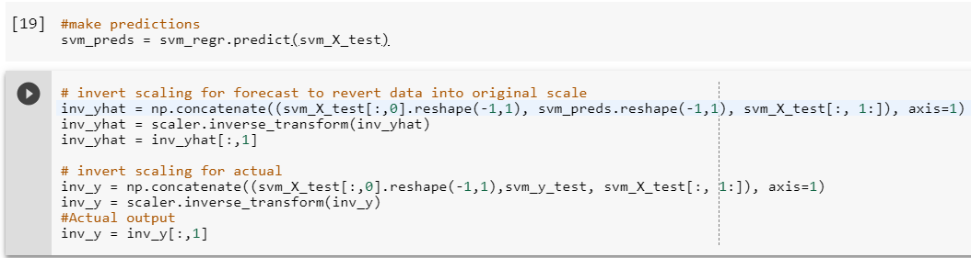
SVM – initial implementation
We take the standardized data and pull the #exits per day out as our y variable, leaving everything else as our X.
Then create a training and test split by leaving the last 31 days (c. a month) of data for testing the model performance.
A standard linear SVM is fitted to the training data using the default parameter values
Predictions are made using the X_test data and scaled back to the original range for ease of comparison

Slide 20
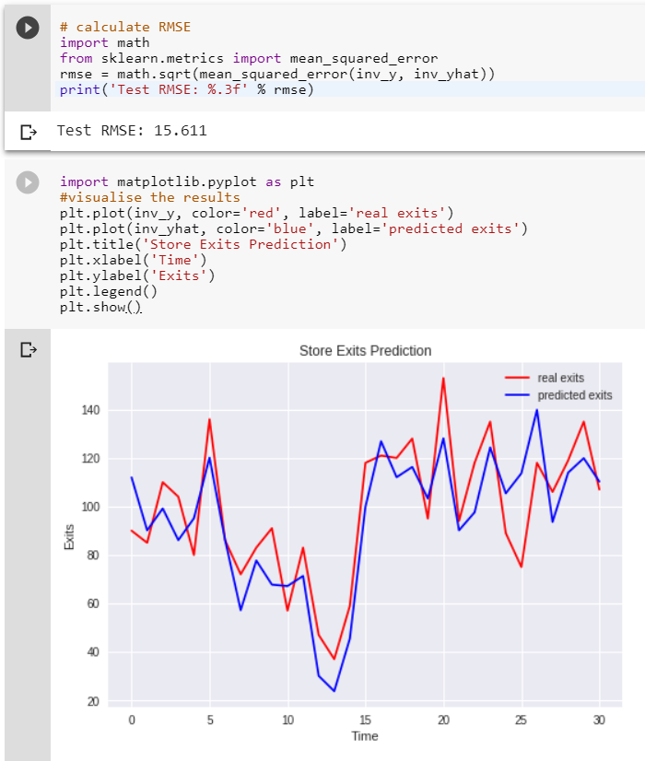
SVM – initial PERFORMANCE
This baseline model looks to be doing a pretty good job according to the line plot, and gives us a decent RMSE value with which to compare

Slide 21
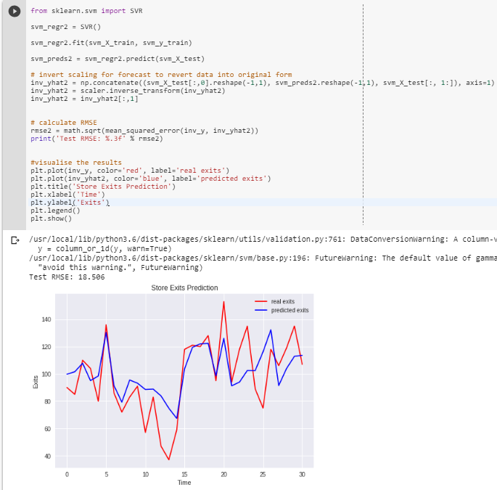
Full SVM implementation
With no parameter tweaks, full SVR as opposed to LinearSVR offers no improvement in performance, in fact, performance declines.

Slide 22


SVM - Next Steps
Next steps will be to run grid-search to test different hyperparameters for the full and linear SVR approaches in search of greater predictive accuracy.
Optimal model will then be compared with best performing models from LSTM and ARIMA sections to judge the overall winner

Slide 23
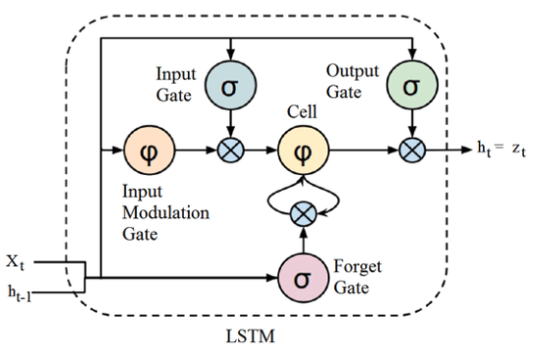


LSTM

